Slide 1
EE 66 Lab
Acoustic Positioning System
We will start at Berkeley Time
Notes:
Remind the lab assistants to ask for the students’ names.
Hi my name is ****. this is our first real lab…

Slide 2
Semester Outline
Shazam
Acoustic Positioning
Voice
Recognition
Image Deconv
Medical Imaging

Slide 3
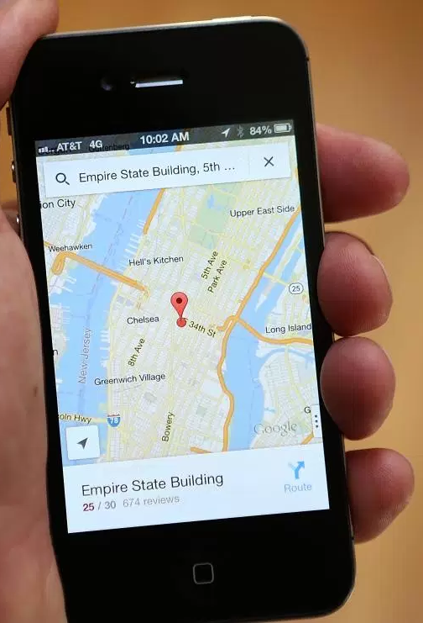
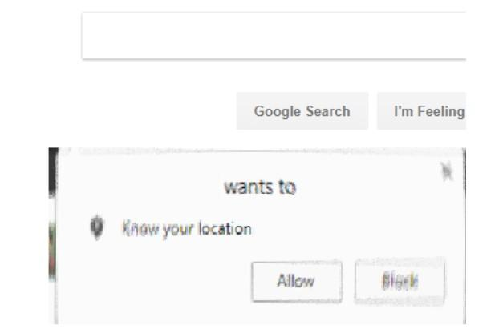
Today’s Lab: Acoustic Positioning System
Global Positioning System (GPS)
  Uses radio waves instead of sound waves
Understand mathematical tools used for shifting and detecting signals
  Think about cross correlation!
ee 66 final fall 26
Babak Ayazifar

Slide 4
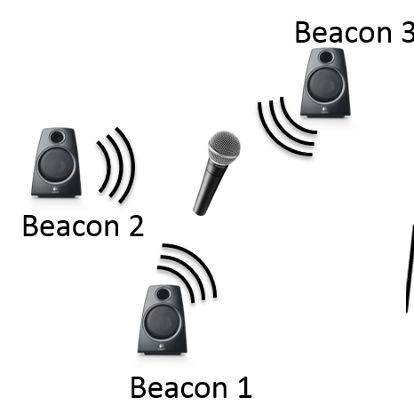
Set-up
General | Lab Specific
Receiver | Microphone
Satellites repeatedly transmitting specific beacon signals | Speakers repeatedly playing specific tones (beacon signals)
Known: Location of each satellite and what beacon signal each satellite is playing
Unknown: Location of receiver ← what we want to figure out!

Slide 5
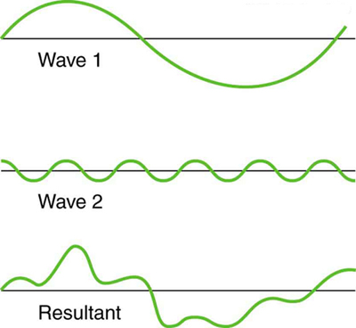
Set-up
Satellite:
  Known, periodic waveforms
  Know satellite location
Receiver:
  Will record the waveform
    Sum of all shifted beacons
  Waveform will be shifted from known satellite waveform based on how far it is from satellite (sound takes time to travel)
Notes:
Rhetorical question: Answer on next slide

Slide 6
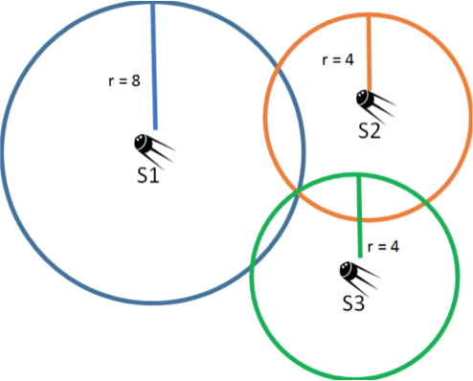
Let’s go backwards
Assume we know the distance between the receiver and every satellite
Use lateration and the satellites’ locations to locate the receiver!
How many satellites do we need in a 2D world?

Slide 7
How do we get those distances?
Assume we know the time-delay (in secs) of every beacon
Use the speed of sound through air to get exactly how far our receiver is from every satellite
  d = v_{s}⋅ t
  v_{s} ≈ 343 m/s

Slide 8

How do we get those time-delays?
Assume we know how many samples it takes for each beacon signal to arrive at the receiver
Use the sampling frequency of receiver to get the time-delay
  Sampling frequency [samples/sec] - rate at which microphone records samples

Slide 9
Poll Time!
Let the sampling frequency be 1000 Hz and the speed of sound be 343 m/s. If I detect a signal with a delay of 100 samples, what is the distance between the speaker and the mic?
3430 m
34.3 m
343 m
3.43 m

Slide 10
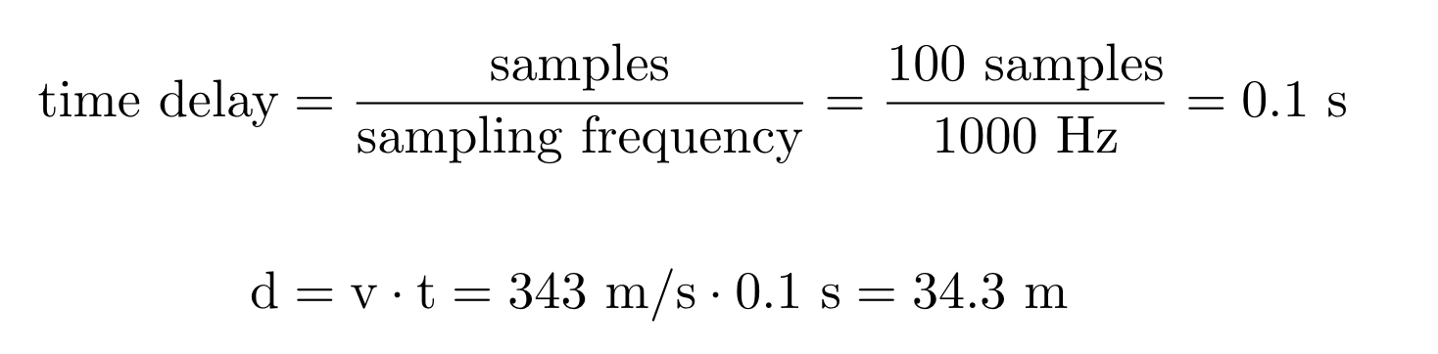
Poll Time!
Let the sampling frequency be 1000 Hz and the speed of sound be 343 m/s. If I detect a signal with a delay of 100 samples, what is the distance between the speaker and the mic?
3430 m
34.3 m →
343 m
3.43 m

Slide 11
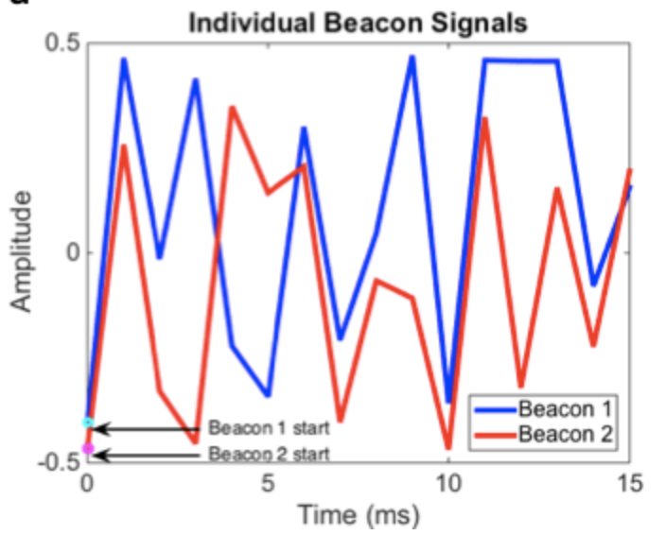
How do we get sample delays?
Receiver’s recorded signal is the sum of all the beacon signals
Need to separate the recorded signal into the individual beacon signals to see how many samples each signal is delayed by

Slide 12
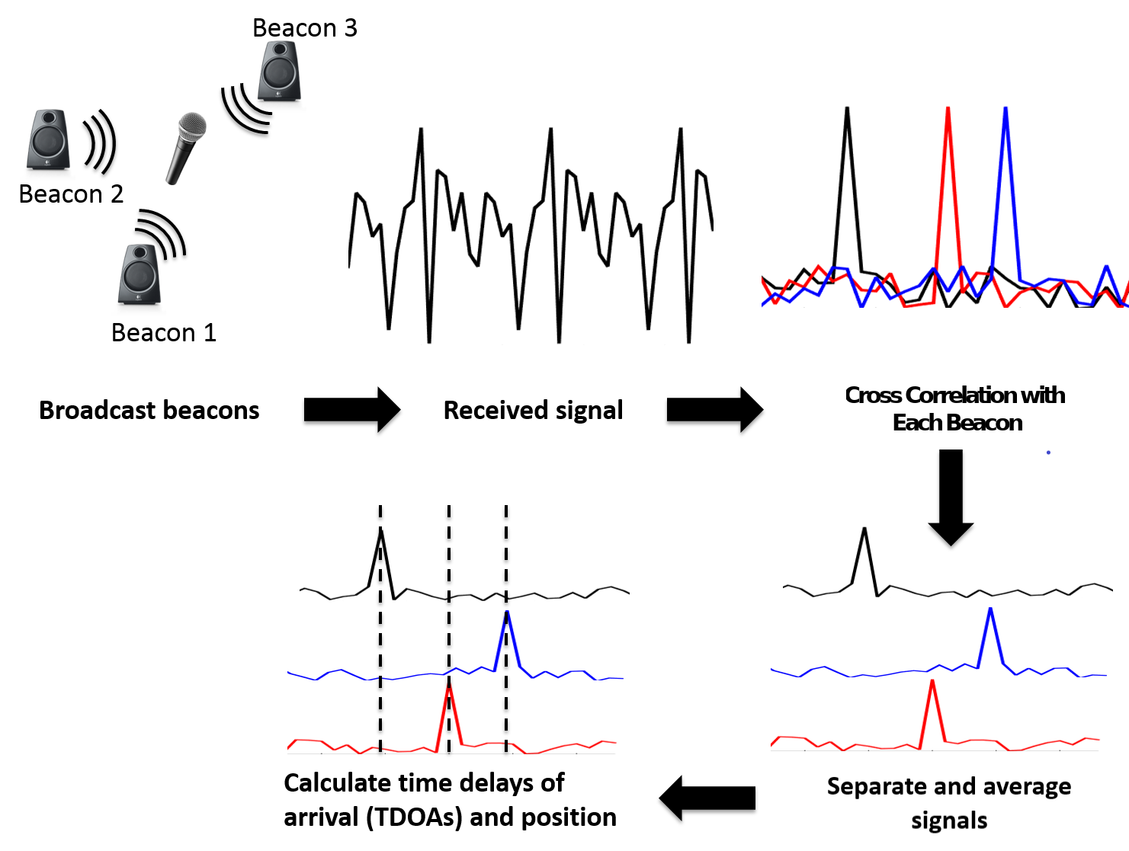
Overview

Slide 13
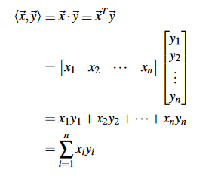
Recall: Inner (Dot) product
Computes how similar two vectors are

Slide 14
Recall: Inner (Dot) product
An alternate form of the dot product
Given this expression, with ||x|| = ||y||, when is this expression maximized?
𝜃 = 0
vectors point in the SAME DIRECTION, so they are the SAME SIGNAL
The bigger the dot product magnitude, the more “similar” the two vectors are

Slide 15
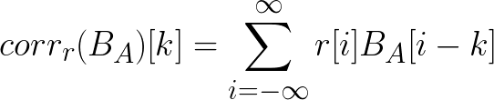
Tool: Cross-correlation
In Python:
cross_correlation(r, B_{A})[k]
Mathematical tool for finding similarities between signals
Idea: Computes dot product between r and signal B_{A} shifted by k samples
From the previous slide, the peak of the cross-correlation vector tells us which shift amount makes B_{A} “most similar” to r

Slide 16
Poll Time!
Given ||x|| = ||y|| = 1, when is the magnitude of the inner product expression maximized?
theta = 0
theta = 90
theta = 180
theta = -90

Slide 17
Poll Time!
Given ||x|| = ||y|| = 1, when is the magnitude of the inner product expression maximized?
theta = 0
theta = 90
theta = 180 (cos 180 = -1)
theta = -90

Slide 18
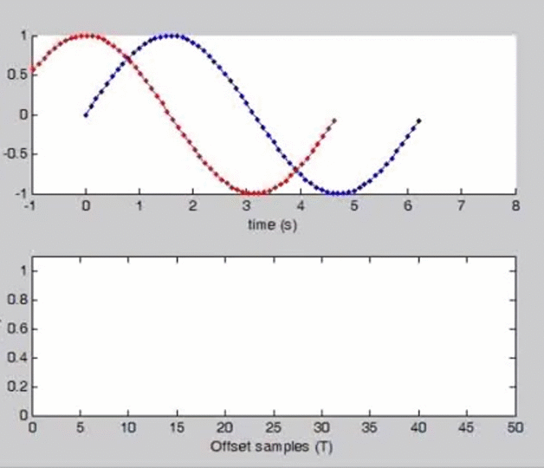
Tool: Cross-correlation
At ~ how many offset samples are the signals most similar?
blue = r
red = B_{A}
Note: zero pad signals
to match length
Notes:
~ 25ish samples

Slide 19
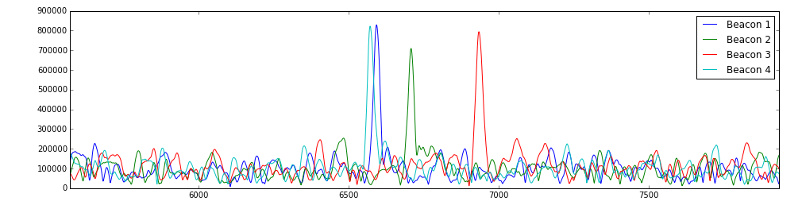
How to use?
Cross correlating should tell us where each beacon signal arrived in our recorded signal
Let’s cross-correlate each of the known beacon signals with what we recorded and plot the result

Slide 20
Absolute or relative sample delays?
We can see peaks where each beacon signal arrived!
But notice it only gives us relative sample delays
  Still can’t tell how many absolute samples each beacon is delayed, we don’t know when it was supposed to arrive
Arbitrarily pick a beacon to be the reference point
Notes:
We don’t know when the beacons arrived, but based off of the offsets we know how much longer it took for beacon 1 to arrive RELATIVE to beacon 0!

Slide 21
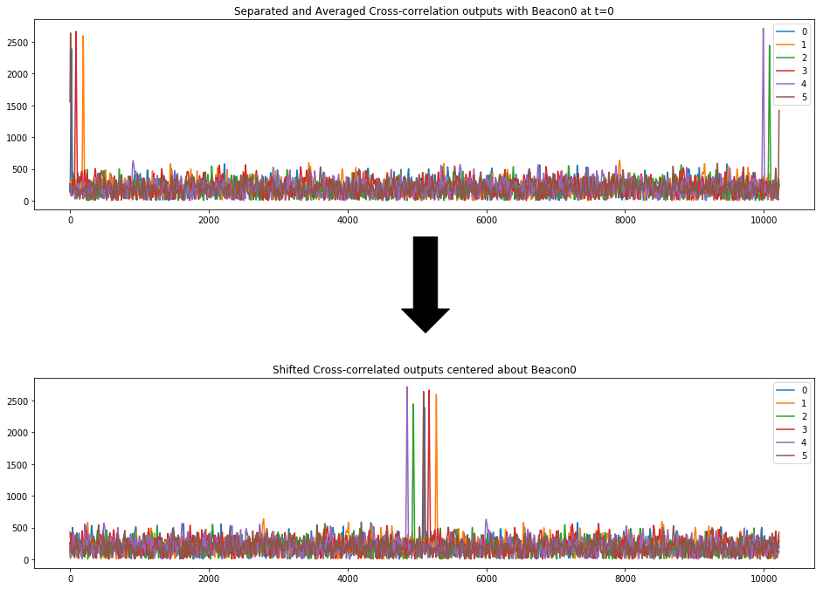
Absolute or relative sample delays?
Let’s shift our axis so beacon 0 has a delay of 0
We could pick any beacon to be the center
  0 is arbitrary
separated signals
Shift and recenter separated signals

Slide 22
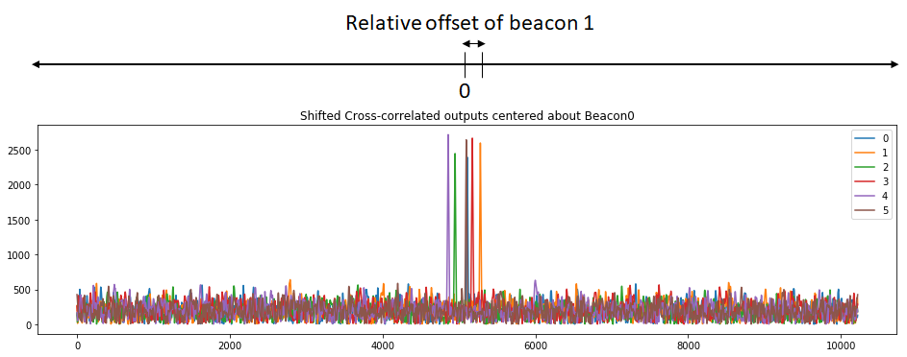
Absolute or relative sample delays?
Now beacon 0 is at our new “origin” and all computations are relative to the new “0” – but how do we find T0?

Slide 23
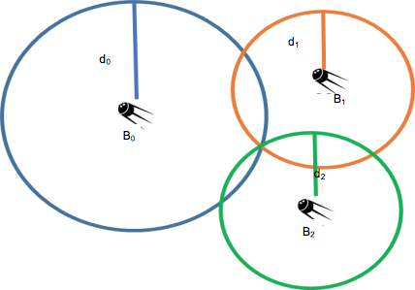
3 Beacon Example
To answer the T0 question, we must formally set up our system. Let beacon centers be: (x₀, y₀), (x₁, y₁) and (x₂, y₂)
Time of arrivals: 𝜏₀, 𝜏₁, 𝜏₂
Distance of beacon m (m = 0, 1, 2) is d_{m} = v𝜏_{m} = R_{m} (circle radii)
Circle equations: (x - x_{m})² + (y - y_{m})² = d²_{m}

Slide 24
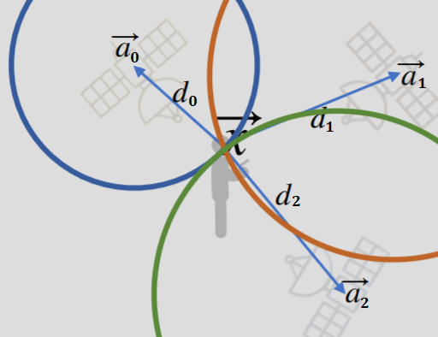




Trilateration
Notes:
||\vec{r}-\vec{a_0}||^2 = d_0^2

Slide 25
Trilateration
Notes:
||\vec{r}||^2 - 2\vec{a_2}^T \vec{r} + ||\vec{a_2}||^2 = v_s^2 \tau_2^2

Slide 26
Trilateration
Subtracting the zeroth equation yields:
and,
Notes:
\implies 2(\vec{a_0} - \vec{a_1})^T \vec{r} = ||\vec{a_0}||^2 - ||\vec{a_1}||^2 + v_s^2(\tau_1^2 - \tau_0^2)

Slide 27

Trilateration
We want to write this in terms of TDOAs and unknowns!
Notes:
(\tau_i^2 - \tau_0^2) = (\tau_i - \tau_0)(\tau_i + \tau_0) = (\tau_i - \tau_0)(\tau_i - \tau_0 + 2\tau_0) = \Delta\tau_i(\Delta\tau_i + 2\tau_0)
2(\vec{a_0} - \vec{a_1})^T \vec{r} - 2(v_s^2 \Delta \tau_1)\tau_0 = ||\vec{a_0}||^2 - ||\vec{a_1}||^2 + v_s^2 \Delta \tau_1^2

Slide 28
Trilateration
What are our unknowns in this system?

Slide 29

Trilateration
What are our unknowns in this system?

Slide 30
Trilateration
What are our unknowns in this system?
Problem: 3 unknowns and 2 equations!
Solution: add another beacon to produce a third equation!

Slide 31
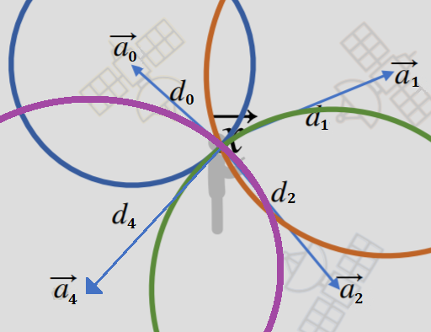
Trilateration
3 equations and 3 unknowns, so we have a solvable system!

Slide 32
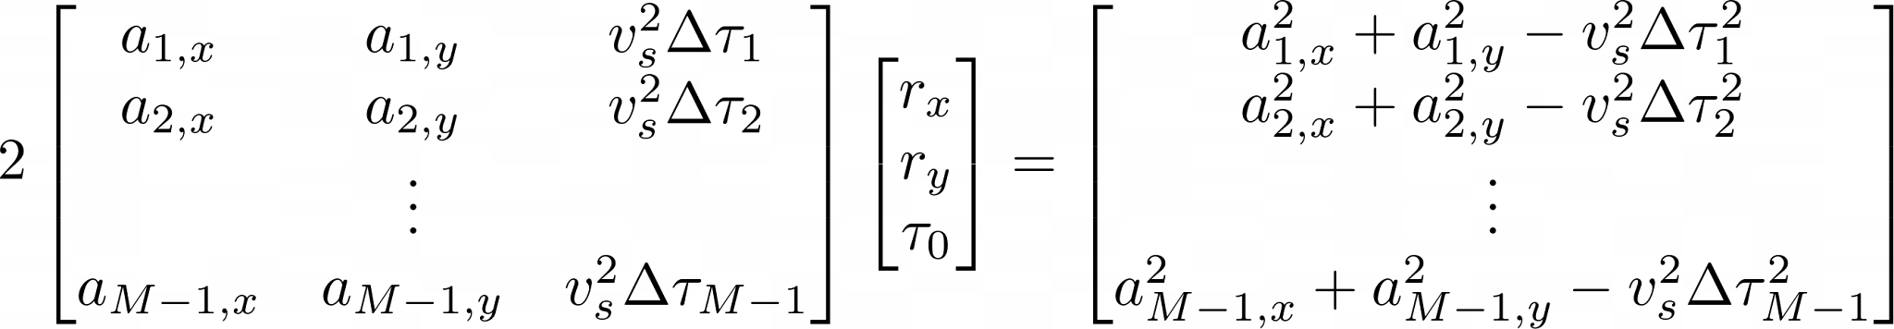
Multilateration
We can produce overdetermined system with M beacons!

Slide 33
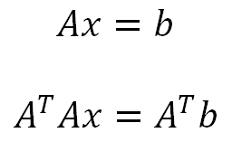
“Solving” an Overdetermined System
After simplifying, we have more equations than unknowns (x,y)
Can do least-squares regardless of number of beacons
Best estimate of location if measurements are inconsistent
If there is no exact point of intersection because of error or noise

Slide 34
Notes for Lab Computer Users
Please use the lab computers and download the “Zip” file from the lab website. Extract the files first. Click on Launch Marimo.bat. This should open the lab notebook.
Might have to hit reload on the notebook tab for pictures to render.
Read over the math carefully, we’ll be asking you about it during the checkoff!

Slide 35
Notes for PC Users
Launchers are verified to work well in Windows
If you have a Mac, you might have a “permission denied” error. Follow these steps to fix that:
Open Terminal.
Type chmod +x (with a space after the x), but don't press Return yet.
Drag Launch Marimo.command from the Finder window into the Terminal window. This pastes its full path.
Press Return.
When prompted in terminal with a y/n type n.

